Slide 1


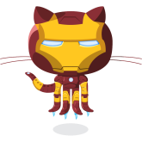
The Many Uses of node.js
Keith Chester
@thekeithchester
hlfshell
This presentation and samples can be found at https://github.com/hlfshell/ManyUsesOfNodejs

Slide 2


Who am I
Work
Senior Developer
Head of Research + Development
Started node.jstl – we’re meeting on May 26th! Find us on meetup!
Has used node for:
Websites (well, duh)
Backend for phone applications
Desktop applications
Microservices
Hardware orchestration
Robots
Messaging services

Slide 3

Why the for node?
Evented = natural
Real Time Programming - node lets your code react in real time
Completely unopinionated
Complete control of any aspect of your application
For many applications – SPEED
Excellent tooling (though not unique to node)

Slide 4
Process vs Object Oriented
node often lends itself more to process oriented programming versus object oriented programming – and that’s OK!
node can do Object Oriented, and some frameworks enforce that! But many modules and tools assume a process oriented approach

Slide 5
A note on ES6 usage
ES6 is the next version of javascript, with some great features that you should definitely learn for your Javascript
ES6 isn’t widely used in browsers due to very little adoption, but it is already mostly adopted in node
Because of low browser adoption, I’ll be avoiding ES6 in all examples unless required to make examples more approachable

Slide 6
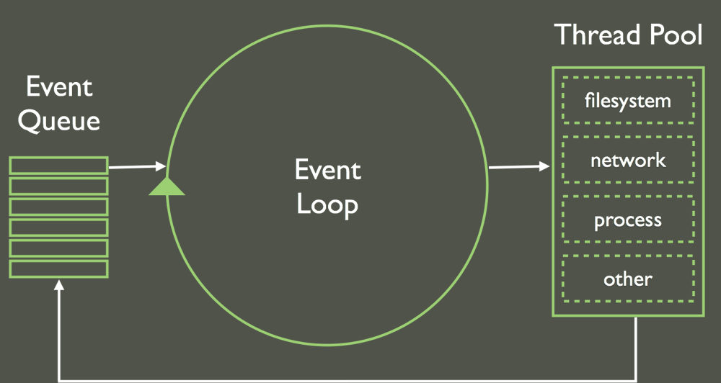
A note on being single-threaded
Avoid blocking code!
Stream whenever possible
One node process = one core

Slide 7
Streams
Modify
Data chunk
Data chunk
Data source
Data out
Think UNIX style processes with pipes

Slide 8
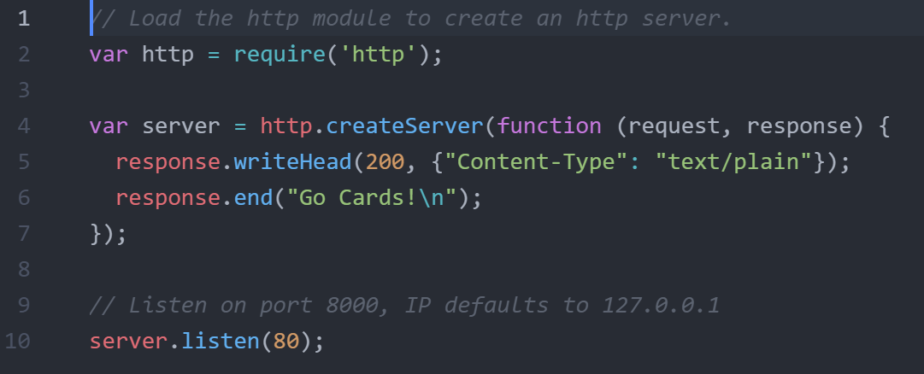
node.js as your web server

Slide 9



Frameworks

Slide 10
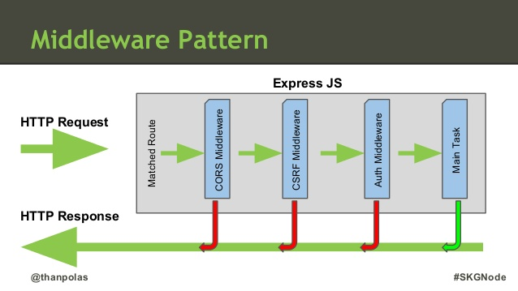
Express
By far the most popular framework

Slide 11
Koa
Made by the creators of express
Made with ES6 in mind – specifically generators

Slide 12
Generators
generators(){
allow(function(you, to){
easilyDeal()
.withNested(function(callbacks){
//Oi!
});
});
}

Slide 13
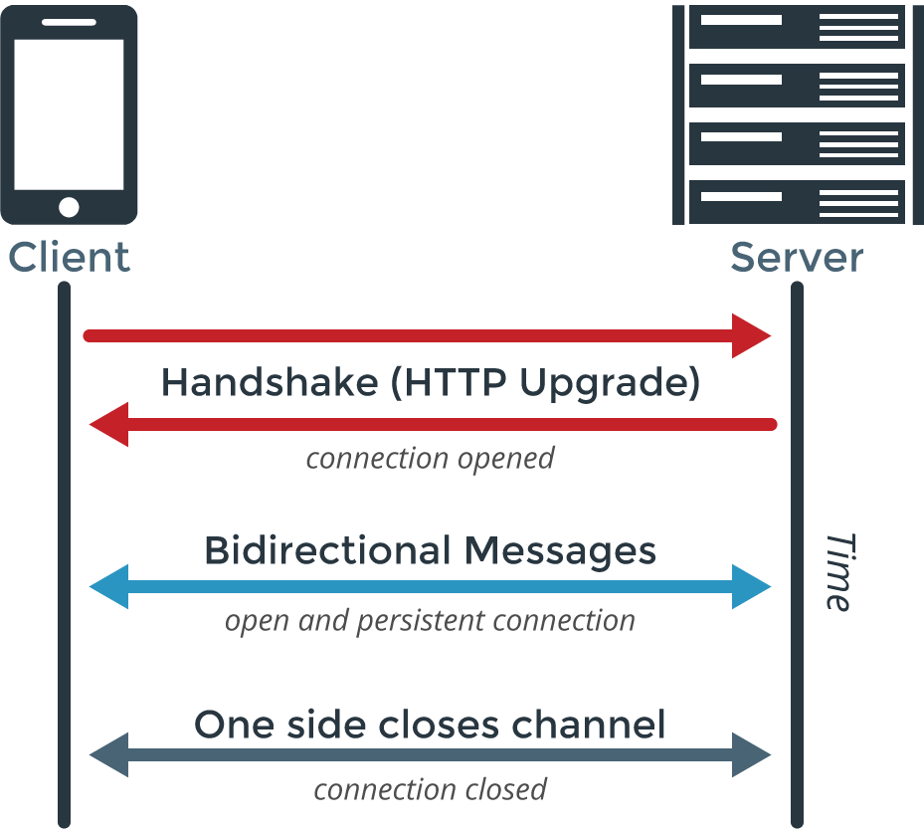
Sockets

Slide 14
ws
For the simplest, get out of my way sockets
Fast
Powers many other frameworks

Slide 15
Physical node.js
This is what I do day in & out
Evented approach plays naturally into user interaction and real life applications

Slide 16
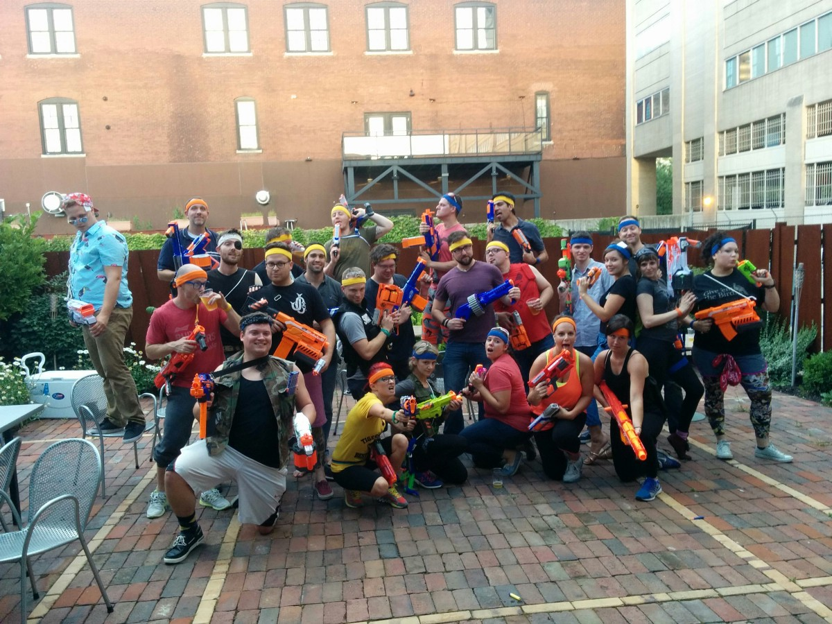
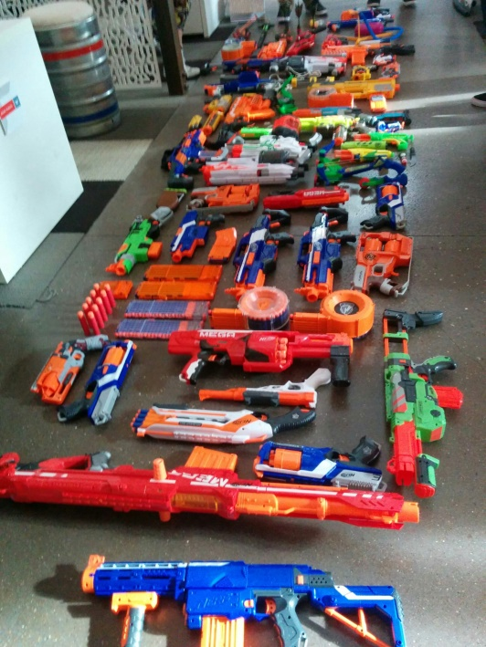
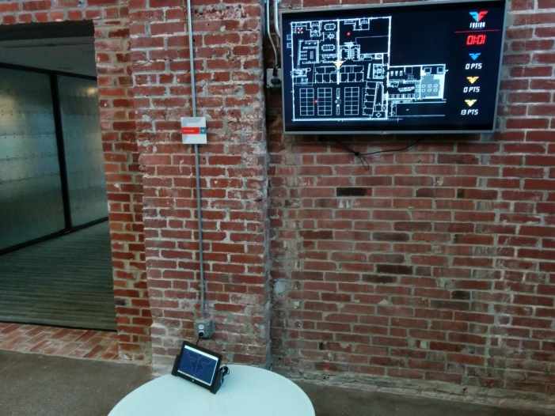
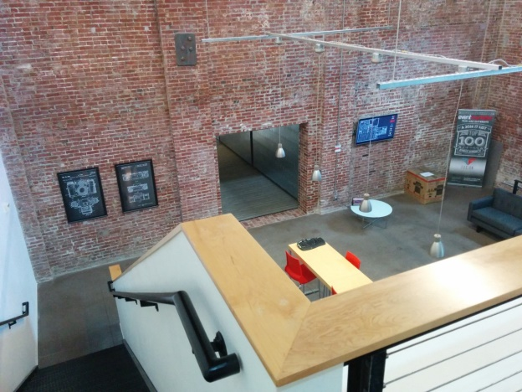
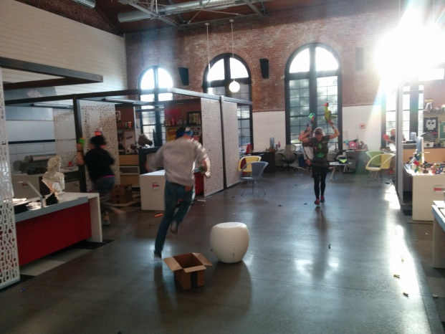
RFID Nerf War?

Slide 17
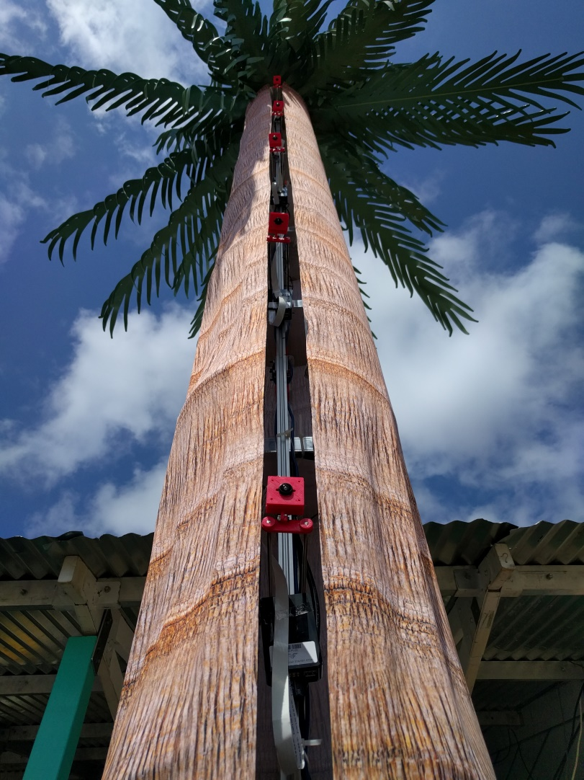
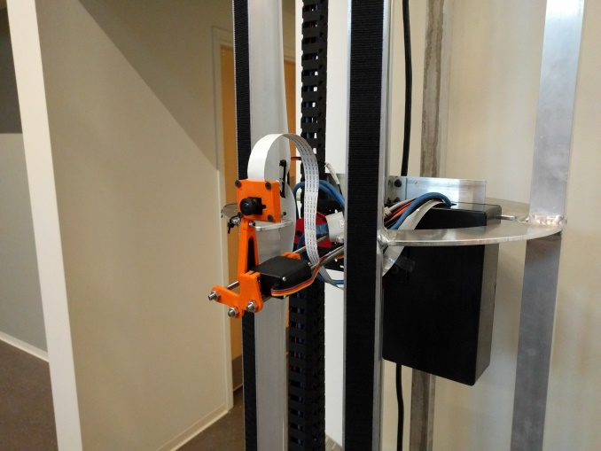
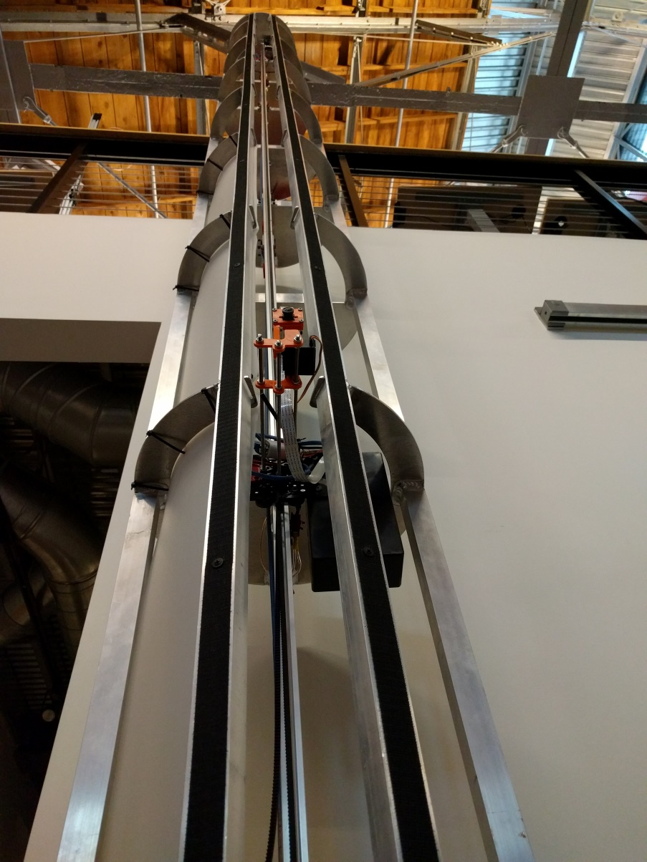
Selfie Tower?
Two socket servers controlling a camera, servos, and a stepper motor w/ 2 subsystem MCUs
Two setups – multiple cameras & most recently – a singular camera w/ a motor moving the camera
Two React based / Firebase backed applications

Slide 18
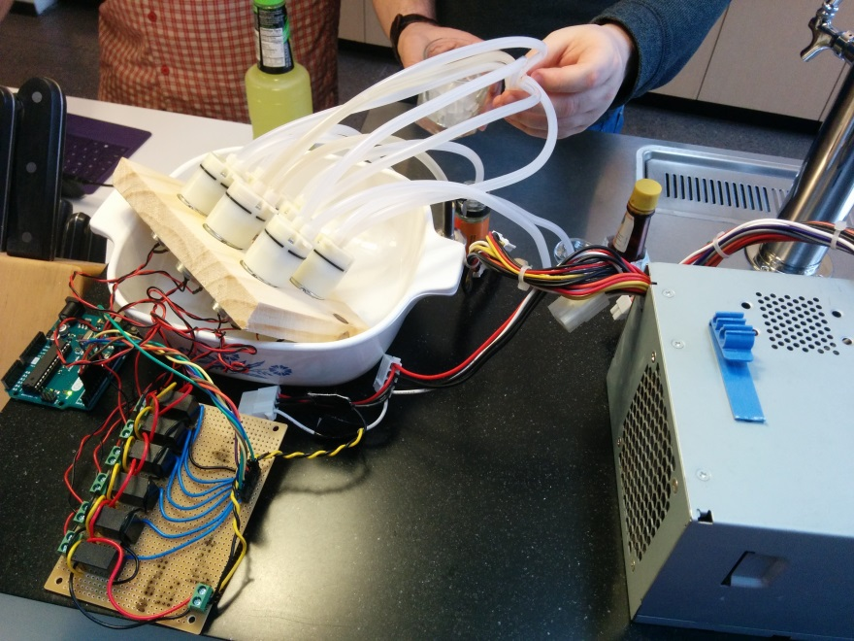
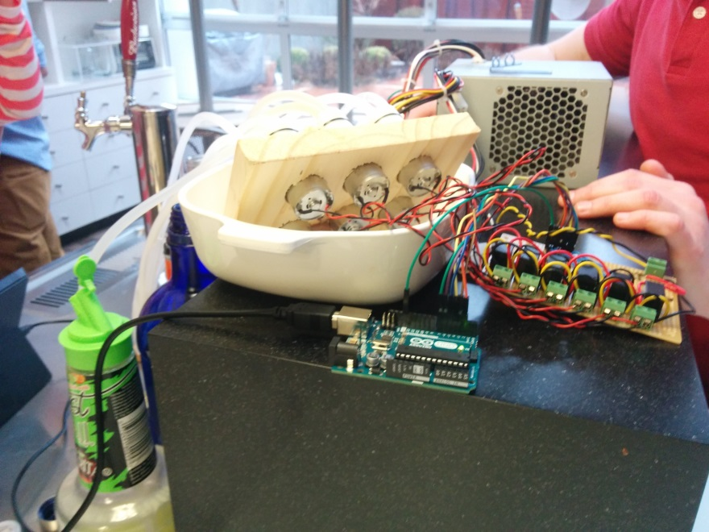
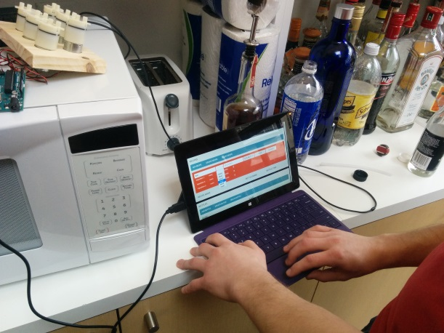
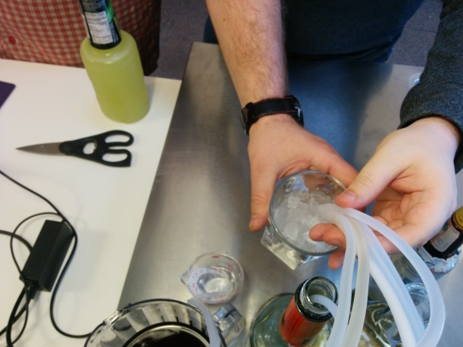
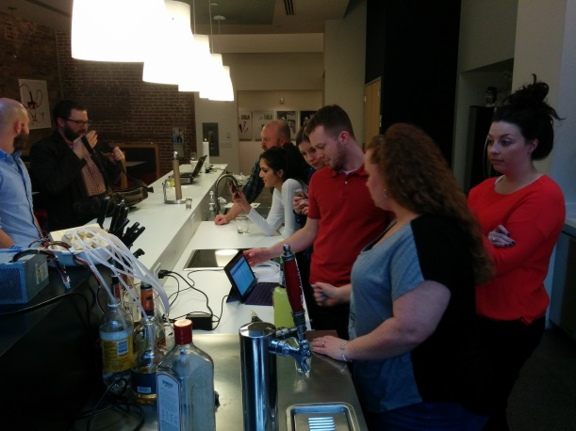
node.js cocktails

Slide 19
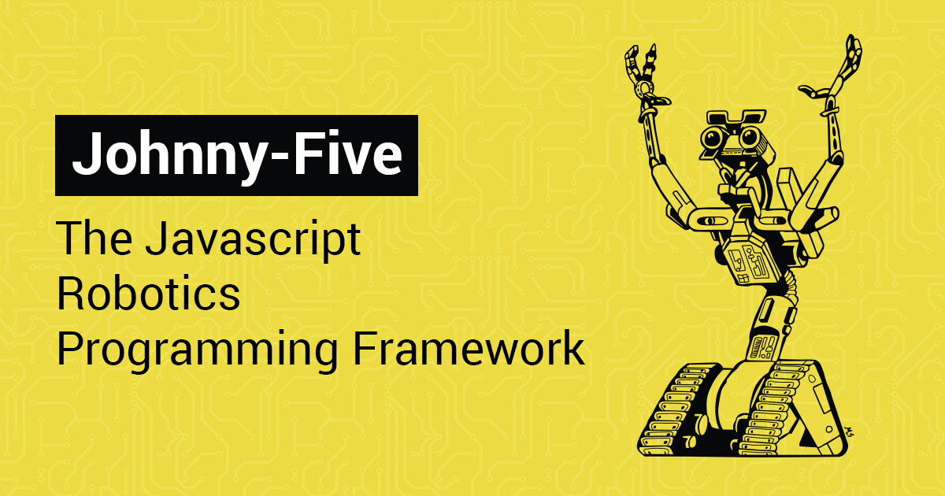
Johnny 5

Slide 20
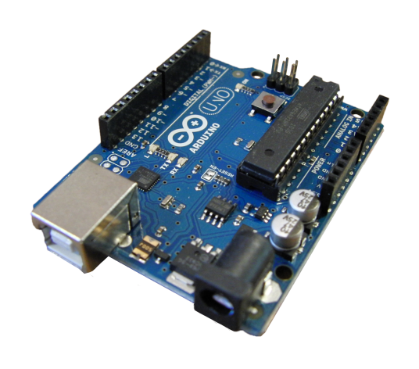
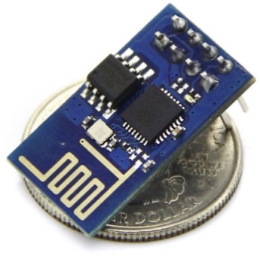
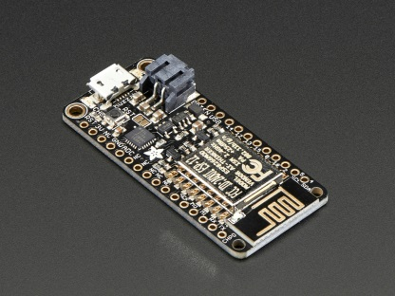
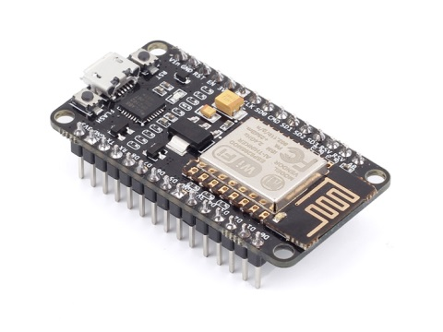
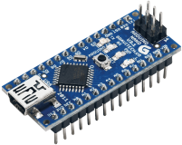
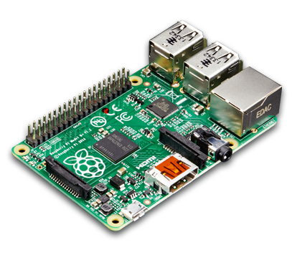
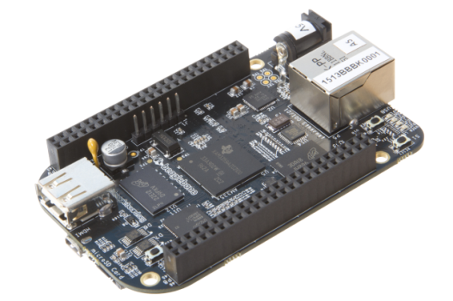
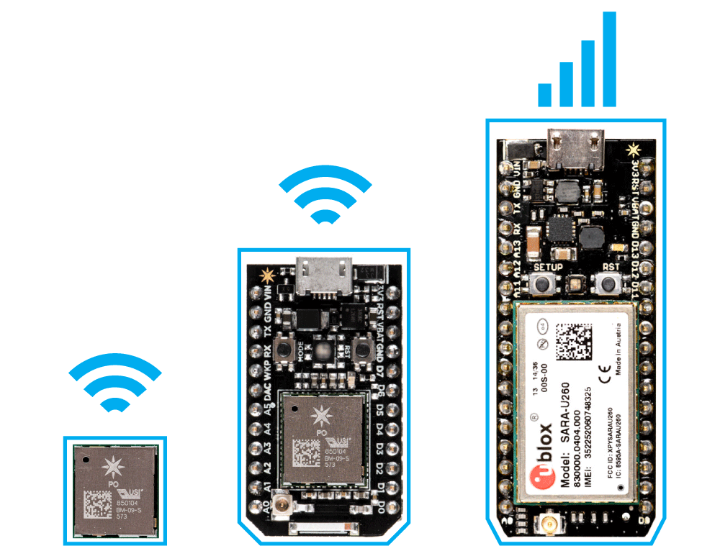
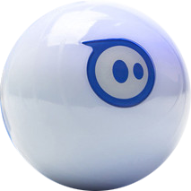
Platforms
Arduinos
ESP8266 module + dev boards
Particle Photon
BeagleBone
Raspberry Pi
Sphero

Slide 21
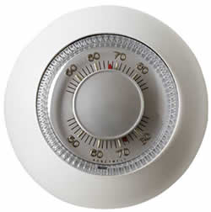
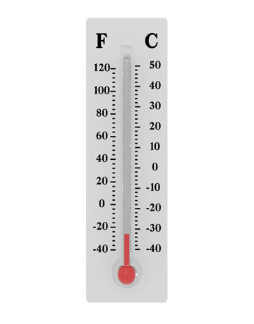
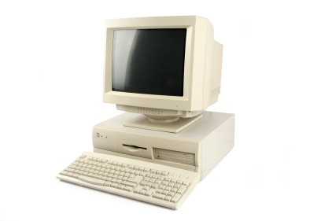
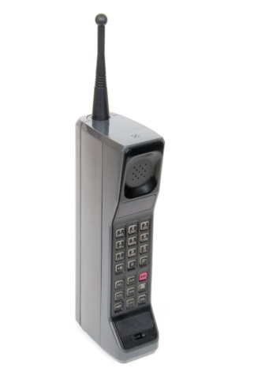
Internet of Things (IoT) and MQTT
Super efficient low memory pub-sub messaging great for IoT
/topic/message
/topic/+/message
/topic/#/message
house/+/temperature
house/kitchen/temperature/-22
-22
Smart Thermostat
Sensor
Broker
#/temperature
Phone app

Slide 22



Packages for MQTT
– The core module that implements simple MQTT
– full MQTT broker (can be standalone)
- multi-transport broker – opens REST HTTP, CoAPP, and MQTT protocols

Slide 23

Microservices
Not just the latest fad – microservices plays nicely into the “node way of thinking”:
Small, bite sized modules to make a larger system

Slide 24


λ
AWS Lambda is a microservice dream
Individual node functions are executed by a predetermined endpoint – no servers!
INFINTE SCALABILITY

Slide 25
Fusion’s Microservices
λ
S3
API
GM
E-mail
SMS
Dynamo
DB
SQL
Mongo

Slide 26

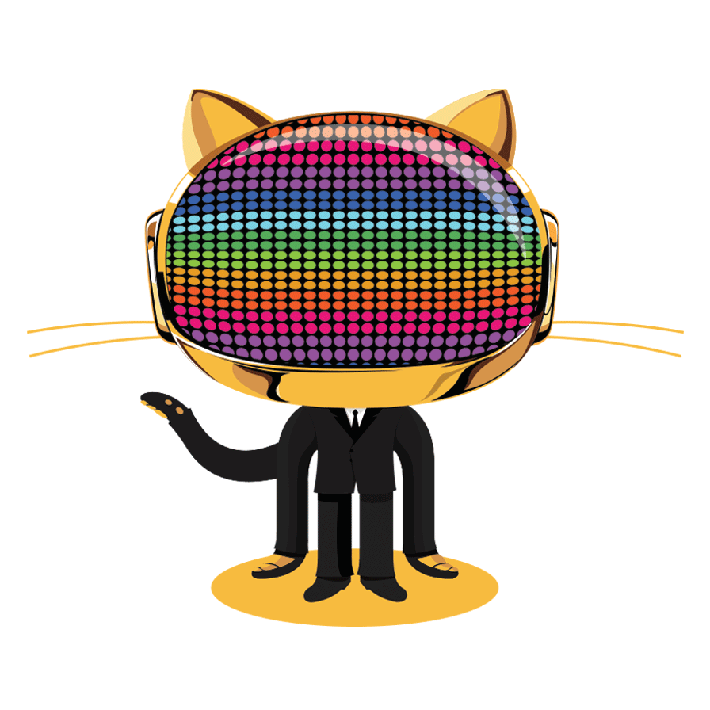

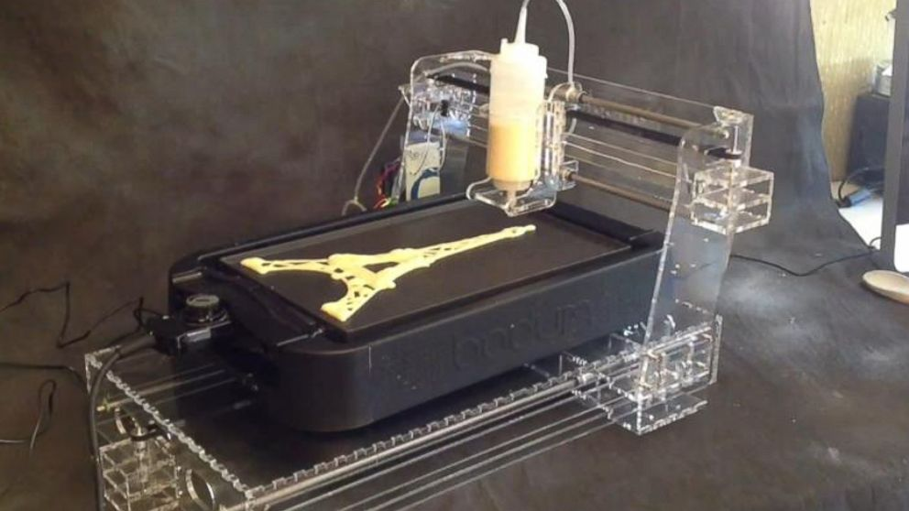


Desktop Applications

Slide 27
Thank You

